Slide 1
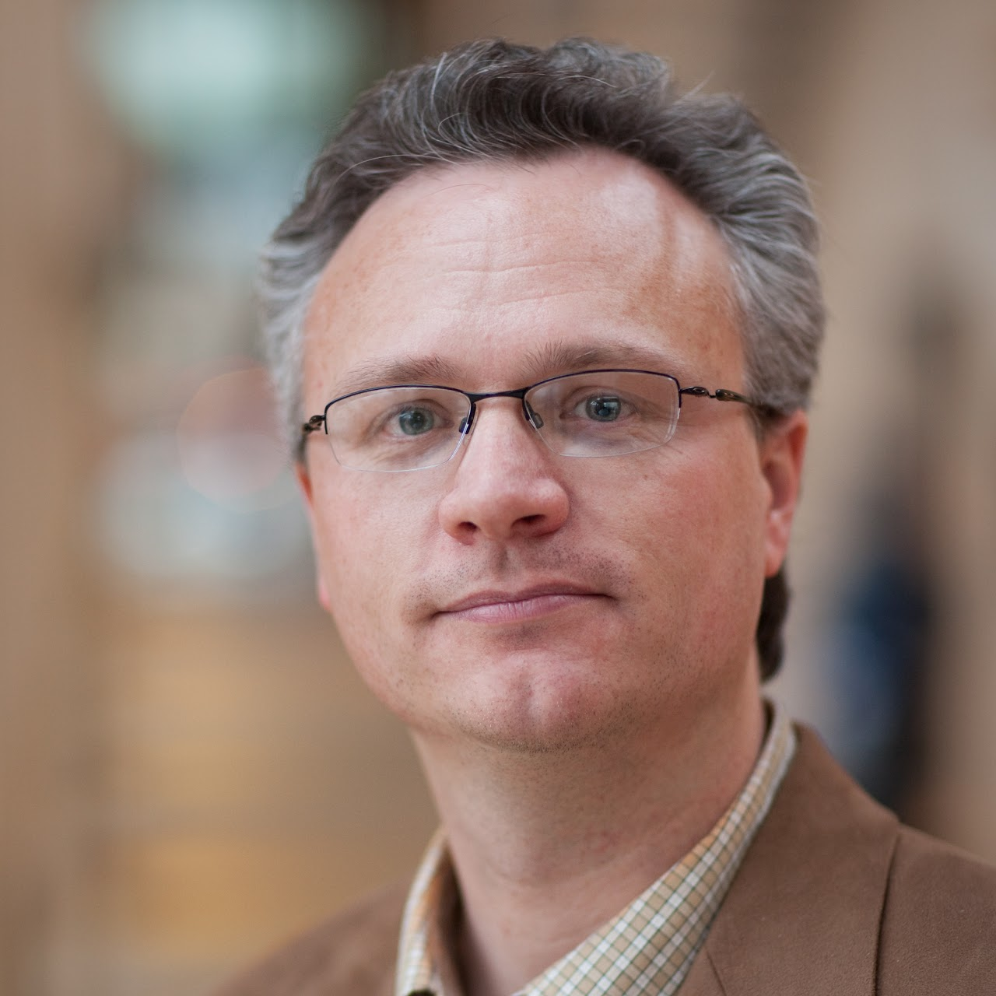
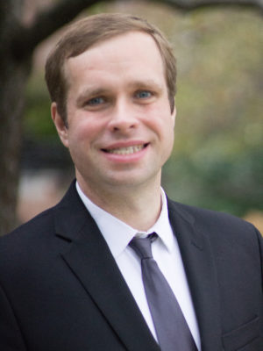
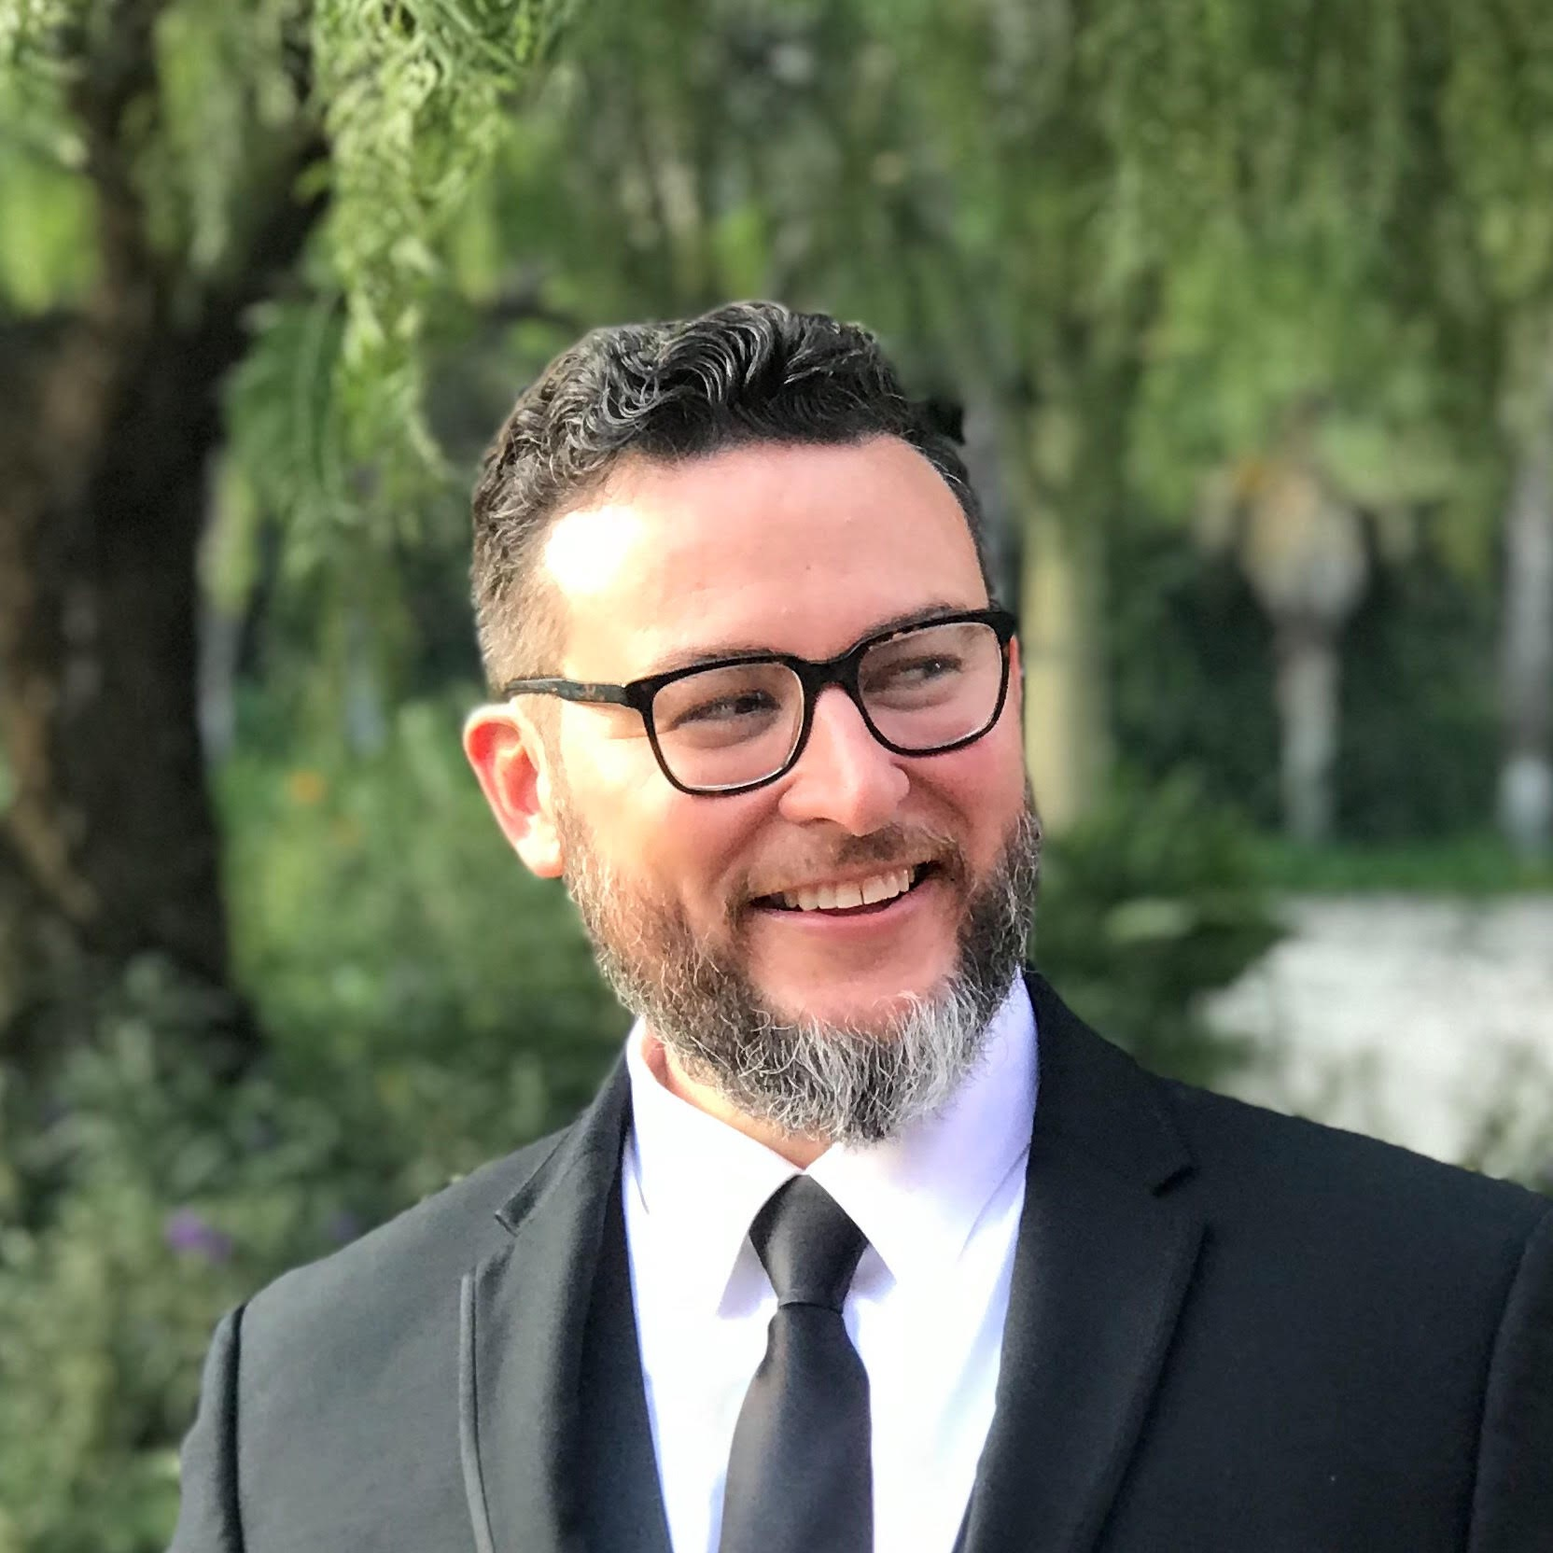
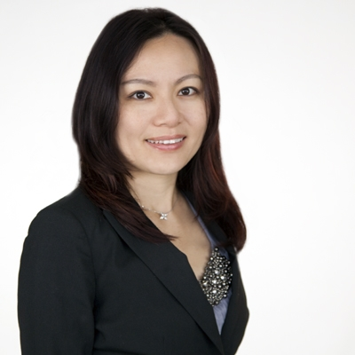
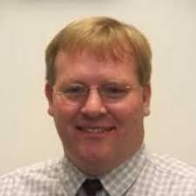
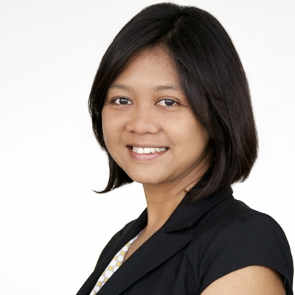
Best practices for McNair Programs in business
April 9th, 2021, 3-4:30pm EST
Register here: https://iastate.qualtrics.com/jfe/form/SV_3KLD1VUa0qSVnCu
More details here: www.mcnairbusinessscholars.org
Please join us for this webinar that is intended for McNair Program directors and business faculty and administrators. We will hear from business school faculty about their experiences with mentoring McNair Scholars and from McNair Program offices about managing the interface between their offices and business schools. Please bring your questions!
Moderator: Mike Barnett, Professor, Rutgers Business School; Founder, McNair Business Scholars Network; McNair Alum, U of Missouri
Panelists: Jeremy Bloss, McNair Scholars Program Coordinator, University of Missouri-Columbia
Francisco Fuentes, McNair Scholars Program Director, California Lutheran University
Jenny Lin, Assistant Professor, College of Business, California State University-Monterey Bay
Doug Moesel, Associate Professor, Trulaske College of Business, University of Missouri-Columbia
Angeline Nariswari, Assistant Professor, College of Business, California State University-Monterey Bay

